Slide 1
COMPARATIVE STUDY : HADOOP MAPREDUCE VS APACHE SPARK
Performance Analysis on the IEEE-CIS Fraud Detection Dataset
Course: Big Data Essential
Lecturer: Kundan Kumar
Link to project code: https://github.com/Elthiero/fintech-hadoop-spark-comparison

Slide 2
OBJECTIVES
INTRODUCTION
HARDWARE & ENVIRONMENT SETUP
DATASET DESCRIPTION
ANALYSIS USING MAPREDUCE
ANALYSIS USING SPARK
COMPARISON ANALYSIS
FINAL INSIGHTS

Slide 3
INTRODUCTION
The primary objective of this project is to process a real-world financial dataset using two dominant Big Data frameworks: Apache Hadoop (via MapReduce) and Apache Spark (viaPySpark). By executing identical aggregation and profiling logic across both paradigms, we aim to generate actionable insights while critically comparing the frameworks based on performance, code complexity, usability, and underlying processing models.

Slide 4
II. HARDWARE & ENVIRONMENT SETUP
To ensure an accurate performance comparison, both frameworks were executed locally on a single-node Windows pseudo-distributed cluster.
System Model: HP Laptop 15-da2xxx
Processor: Intel® Core™ i7-10510U CPU @ 1.80GHz (8 CPUs)
Memory: 16 GB RAM
Operating System: Windows 11 Pro 64-bit

Slide 5
III. DATASET DESCRIPTION
The analysis utilizes the IEEE-CIS Fraud Detection dataset, originally provided by Vesta Corporation via Kaggle, with a total size: 1.2 GB (Uncompressed). We will use train_transaction.csv (667 MB), the main transaction data(394 columns and 590,540 rows).
Link to dataset: https://www.kaggle.com/c/ieee-fraud-detection/data
We will analyze the Transaction Health by Card Network by calculating:
Total transaction volume
Average transaction amount
Fraud percentage

Slide 6
III. DATASET DESCRIPTION (Continued)
We will focus on these columns for the analysis:
TransactionID: Unique ID for each row, primary Key for Joining
isFraud: Binary (0 = Legit, 1 = Fraud), target Variable for risk profiling
TransactionAmt: Transaction Amount (USD), main Metric for Aggregation
card4: Card Network (Visa, Mastercard), grouping Category
Data Ingestion Strategy (Schema-on-Read): The raw, train transaction.csv (667 MB) file was uploaded directly to HDFS. The parsing, filtering, and schema application were deferred entirely to the distributed processing engines.
We uploaded and created required files, and directories.

Slide 7
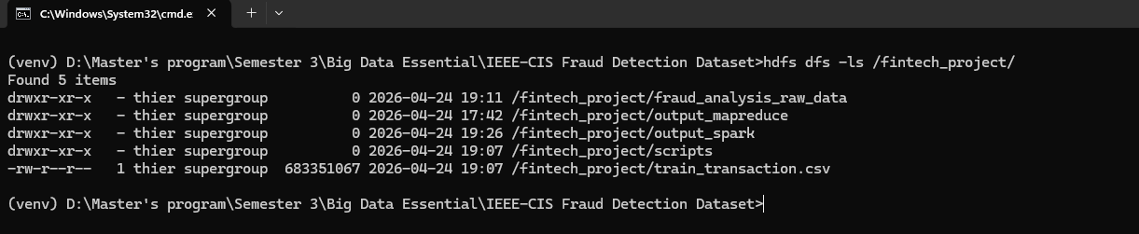
Figure 1: Listing directories and files on hdfs.

Slide 8
IV. ANALYSIS USING MAPREDUCE
The first implementation utilized Hadoop Streaming to execute custom Python scripts across the YARN resource manager.
Mapper: Implemented dynamic column indexing by reading the CSV header on the fly. It utilized a try/except block to extract card4, TransactionAmt, and isFraud. Missing card values were dynamically imputed as ’unknown’.
Reducer: Aggregated the shuffled keys, maintaining a running sum of total amounts, transaction counts, and fraud cases to calculate the final averages and fraud rates.
The job was submitted to the cluster using the hadoop-streaming utility. The YARN ResourceManager successfully allocated splits, surviving multiple task fetch failures via its built-in fault tolerance.

Slide 9
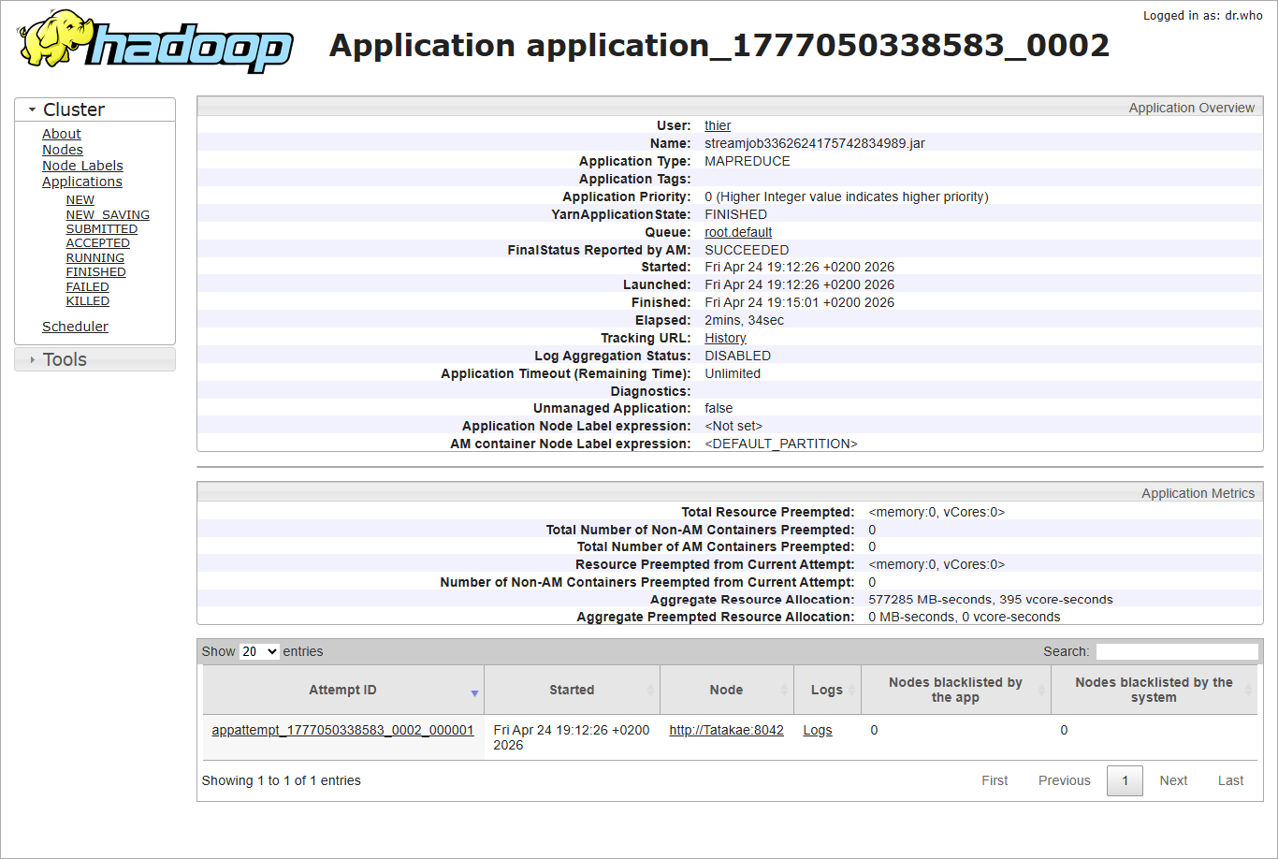
Figure 2: Verification of active cluster nodes and HDFS health.

Slide 10
V. ANALYSIS USING SPARK (PySpark)
The second implementation accessed the exact same 667 MB raw CSV directly from HDFS using Apache Spark’s DataFrame API. Unlike MapReduce, Spark’s robust native CSV parser automatically handled quoted delimiters and inferred the schema across all 394 columns dynamically. The aggregation logic was condensed into a single functional block:
result = df.groupBy("card4").agg(
sum("TransactionAmt").alias("Total Amount"),
avg("TransactionAmt").alias("Average Amount"),
round((count(when(col("isFraud")==1,True))/count("*")* 100),2).alias("Fraud (%)")
)

Slide 11
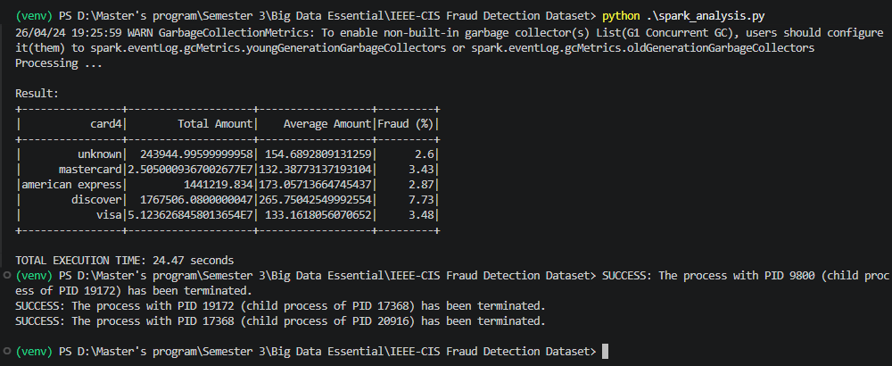
Figure 3: PySpark output.

Slide 12
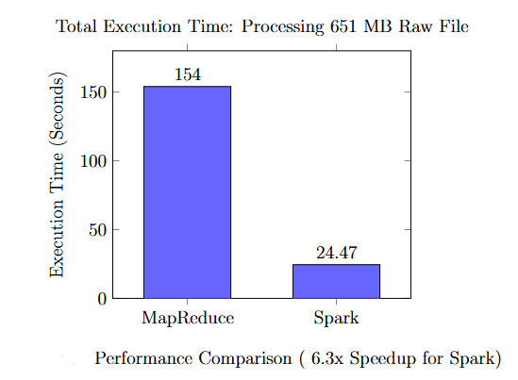
VI. COMPARISON ANALYSIS
Performance:
The most dramatic difference observed was in execution time. Processing the raw 667 MB dataset took MapReduce exactly 2 minutes and 34 seconds (154 seconds) due to the heavy disk I/O required between the Map, Shuffle, and Reduce phases. Apache Spark processed and parsed the entire raw dataset in just 24.47 seconds by executing the logical DAG in-memory.

Slide 13
VI. COMPARISON ANALYSIS (Continued)
2. Code Complexity & Parsing Robustness
MapReduce: High complexity and fragile. Implementing ”Schema-on-Read” required manually mapping indices and catching cast exceptions. Furthermore, using a naive .split(’,’) in Python caused the Mapper to silently drop rows where strings contained internal commas (e.g., location strings), resulting in massive data loss (recording only ∼$9.3M for Visa).
Spark: Low complexity and highly robust. PySpark abstracted the schema definition and utilized an enterprise-grade CSV parser that flawlessly handled complex text fields without data loss, correctly capturing the full $51.2M volume for Visa.
3. Processing Model
MapReduce (Disk-Based): Required reading from HDFS, writing intermediate Map outputs to local disk, shuffling across the network, and writing final Reduce outputs back to HDFS.
Spark (In-Memory): Built a Directed Acyclic Graph (DAG) of logical steps, executing the aggregation entirely in RAM before writing the final output.

Slide 14

SUMMARY COMPARISON: MAPREDUCE VS. SPARK
Criteria
Hadoop MapReduce
Apache Spark (PySpark)
Processing Model
Disk-based (heavy I/O across Map, Shuffle, and Reduce phases).
In-memory (builds a Directed Acyclic Graph for execution).
Execution Time
154.00 seconds (2m 34s).
24.47 seconds (~6.3x faster).
Code Complexity
High. Requires separate Mapper/Reducer scripts and manual state tracking.
Low. Abstracted via declarative DataFrame API in a single script.
Data Parsing
Fragile. Naive string splitting (.split(',')) failed on complex text fields.
Highly Robust. Native enterprise parser automatically inferred schema.
Data Fidelity
Significant loss. Unhandled parsing errors forced Mapper to drop rows.
100% fidelity. Successfully captured entire $51.2M Visa volume.
Fault Tolerance
Excellent. YARN caught shuffle timeouts and restarted tasks.
Excellent. RDDs allow for seamless recovery via lineage graphs.
Table 1: Framework Comparison: Hadoop MapReduce vs. Apache Spark

Slide 15
VII. FINAL INSIGHTS
Business Insights
Volume vs. Risk: Visa/Mastercard dominate with ~3.4% fraud rate, but Discover presented a 7.73% anomaly.
The Cost of "Dirty Data": MapReduce's lack of a sophisticated parser led to substantial record drops compared to Spark, highlighting a critical data engineering lesson.
Architectural Recommendations
1. Use Spark for: Modern ETL and iterative aggregations. Provided 6.3x performance gain and 100% data fidelity.
2. Use MapReduce for: Massive batch jobs exceeding RAM or specialized unstructured data where custom Python mappers excel.

Slide 16

THANK YOU
Comparative Study: Hadoop MapReduce vs. Apache Spark
Github Repository

